Slide 1
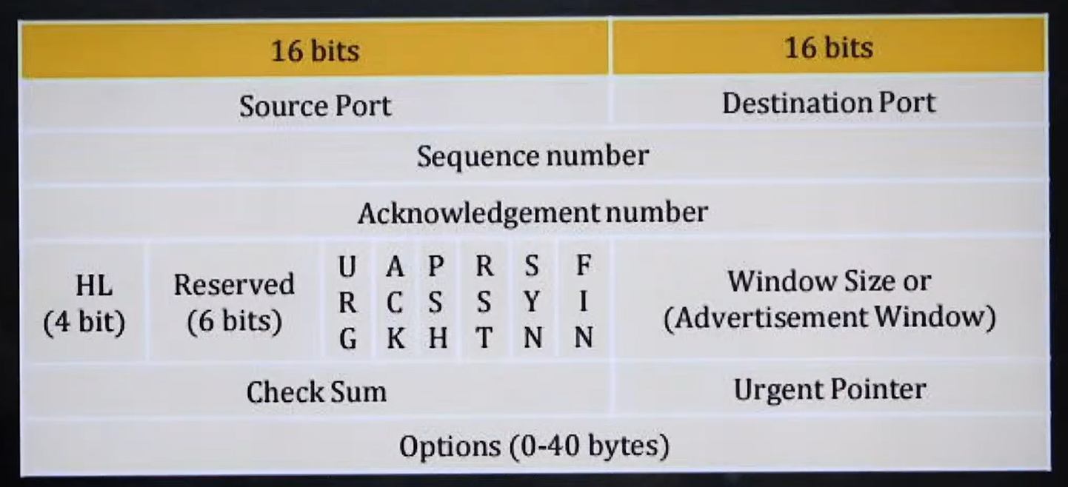

Slide 2
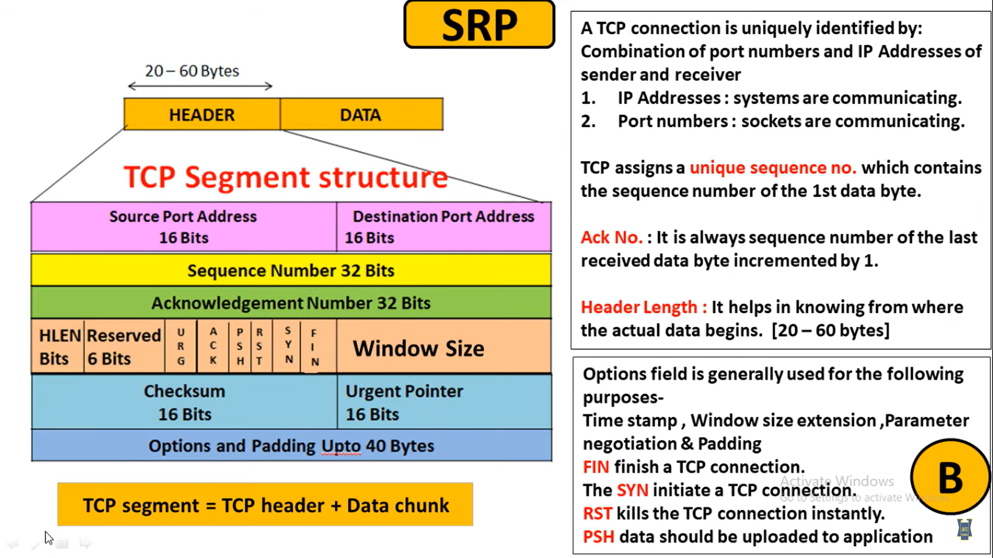

Slide 3
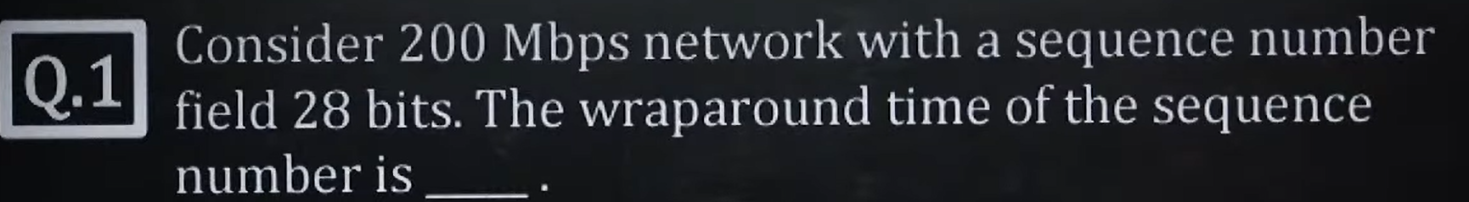

Slide 4
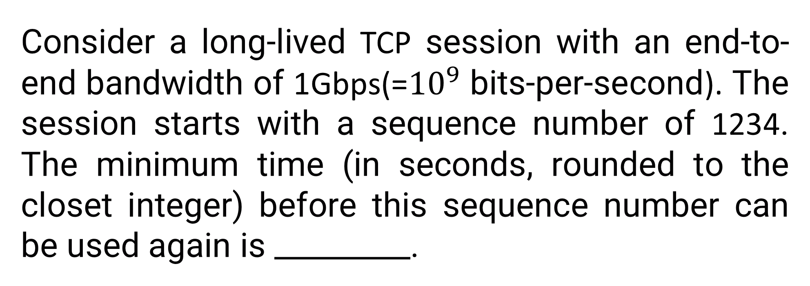
Consider a long-lived TCP session with an end-to-end bandwidth of 1Gbps(=${10}^{9}$ bits-per-second). The session starts with a sequence number of 1234. The minimum time (in seconds, rounded to the closet integer) before this sequence number can be used again is _________.

Slide 5
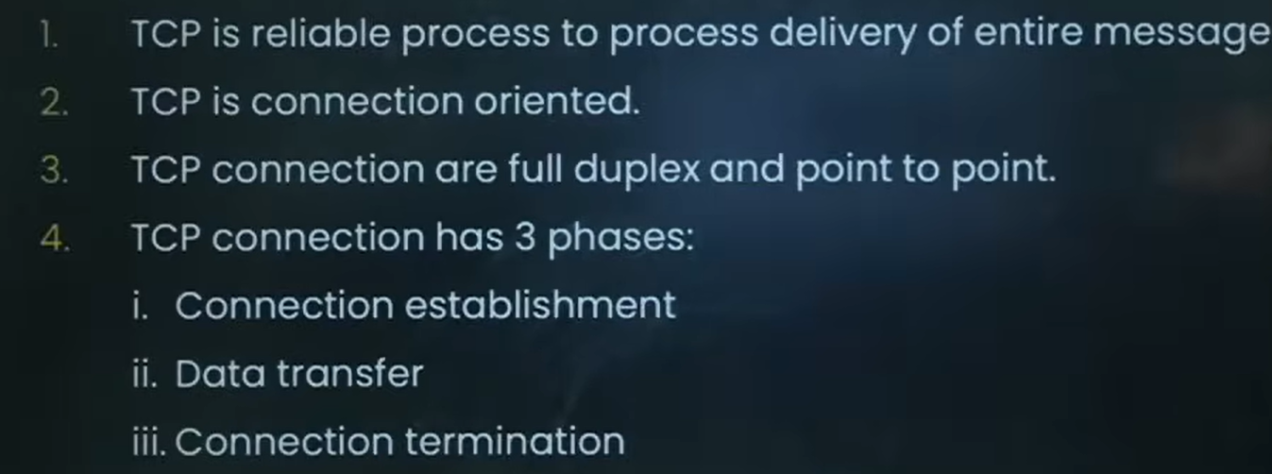

Slide 6
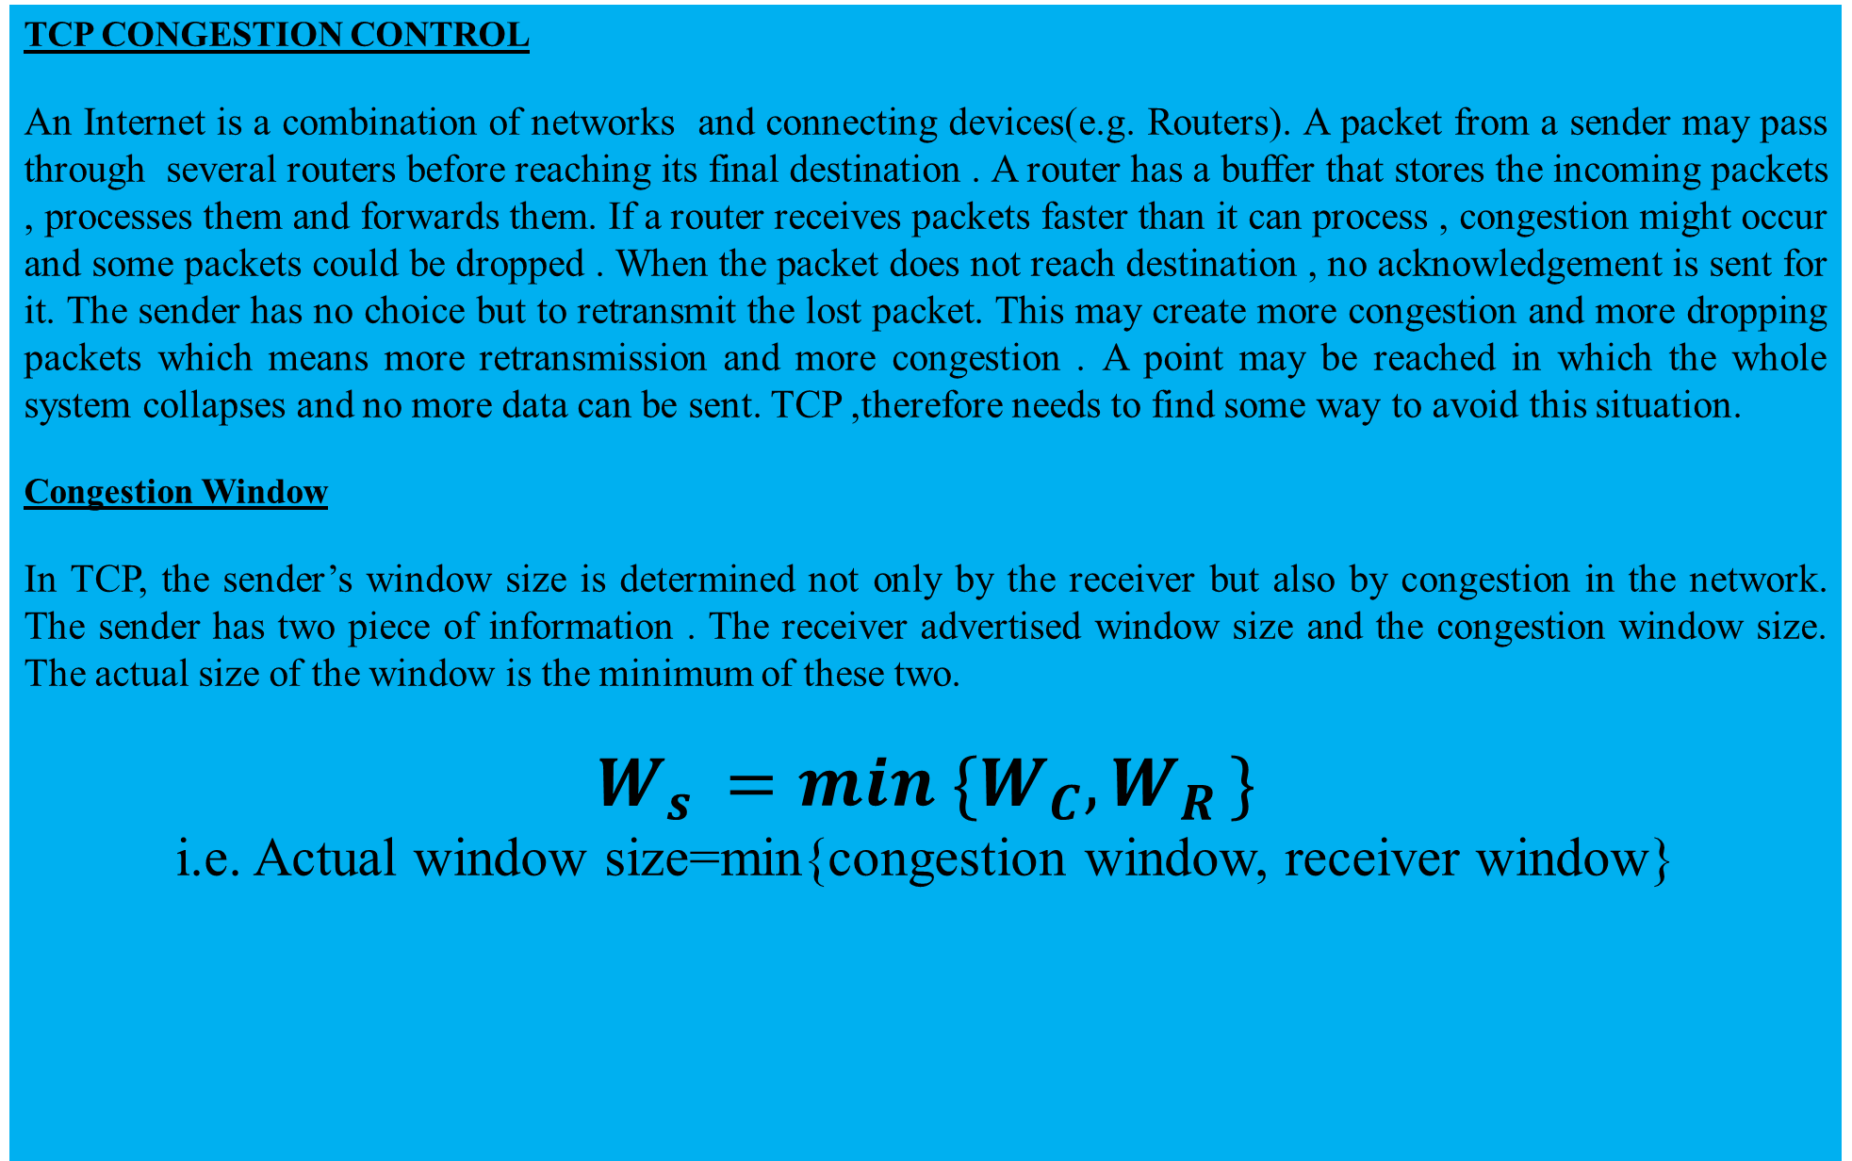
TCP CONGESTION CONTROL
An Internet is a combination of networks and connecting devices(e.g. Routers). A packet from a sender may pass through several routers before reaching its final destination . A router has a buffer that stores the incoming packets , processes them and forwards them. If a router receives packets faster than it can process , congestion might occur and some packets could be dropped . When the packet does not reach destination , no acknowledgement is sent for it. The sender has no choice but to retransmit the lost packet. This may create more congestion and more dropping packets which means more retransmission and more congestion . A point may be reached in which the whole system collapses and no more data can be sent. TCP ,therefore needs to find some way to avoid this situation.
Congestion Window
In TCP, the sender’s window size is determined not only by the receiver but also by congestion in the network. The sender has two piece of information . The receiver advertised window size and the congestion window size. The actual size of the window is the minimum of these two.
$W_{s }=min \{W_{C},W_{R }\}$
i.e. Actual window size=min{congestion window, receiver window}

